Slide 1
Introduction to
Genetic Algorithms

Slide 2
History
Pioneered by John Holland in the 1970’s
Got popular in the late 1980’s
Based on ideas from Darwinian Evolution
Can be used to solve a variety of problems that are not easy
to solve using other techniquesof innovation, creativity, etc.

Slide 3
Evolution in the real world
Each cell of a living thing contains chromosomes - strings of DNA
! Each chromosome contains a set of genes - blocks of DNA
! Each gene determines some aspect of the organism (like eye
colour)
! A collection of genes is sometimes called a genotype
! A collection of aspects (like eye colour) is sometimes called a
phenotype
! Reproduction involves recombination of genes from parents and
then small amounts of mutation (errors) in copying
! The fitness of an organism is how much it can reproduce before it
dies
! Evolution based on “survival of the fittest”

Slide 4
Start with a Dream…
! Suppose you have a problem
! You don’t know how to solve it
! What can you do?
! Can you use a computer to somehow find a solution for you?
! This would be nice! Can it be done?

Slide 5
A dumb solution
Repeat
Generate a random feasible solution
Test the solution to evaluate its “goodness”
Until solution is good enough

Slide 6
Can we use this dumb idea?
Sometimes - yes:
! if there are only a few possible solutions
! and you have enough time
! then such a method could be used
! For most problems - no:
! many possible solutions
! with no time to try them all
! so this method can not be used

Slide 7
A “less-dumb” idea (GA)
Generate a set of random solutions
Repeat
Test each solution in the set and rank them
Remove some bad solutions from set
Duplicate some good solutions
Make small changes to some of them
Until “best” solution is good enough

Slide 8
How do you encode a solution?
Obviously this depends on the problem!
! GA’s often encode solutions as fixed length “bitstrings” (e.g.
101110, 111111, 000101)
! Each bit represents some aspect of the proposed solution to
the problem
! For GA’s to work, we need to be able to “test” any string and
get a “score” indicating how “good” that solution is

Slide 9
Silly Example - Drilling for Oil
Imagine you had to drill for oil somewhere along a single
1km desert road
! Problem: choose the best place on the road that produces
the most oil per day
! We could represent each solution as a position on the road
! Say, a whole number between [0..1000]

Slide 10
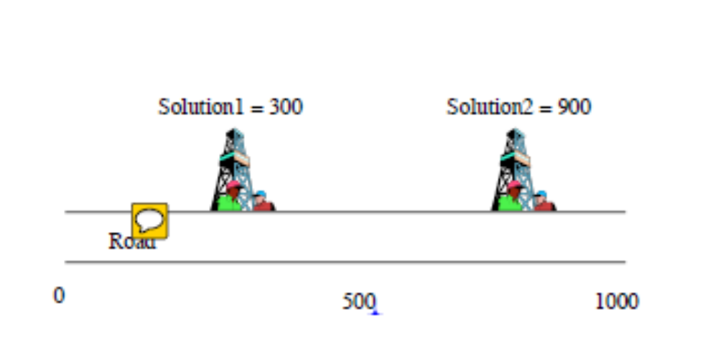
Where to drill for oil?

Slide 11
Digging for Oil
The set of all possible solutions [0..1000] is called the search
space or state space
! In this case it’s a one-dimensional interval but it could be
multi dimensional
! Often GA’s code numbers in binary producing a bitstring
representing a solution
! In our example we choose 10 bits which is enough to
represent 0..1000

Slide 12
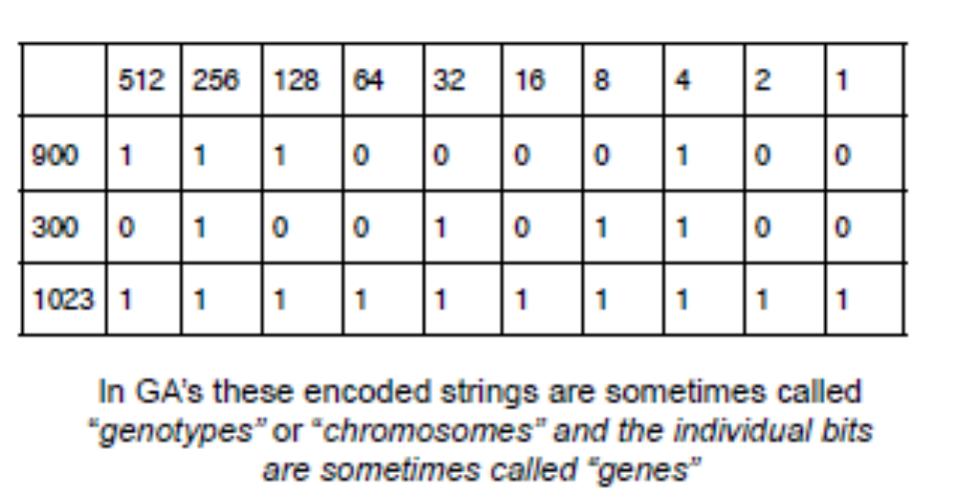
Convert to binary string

Slide 13
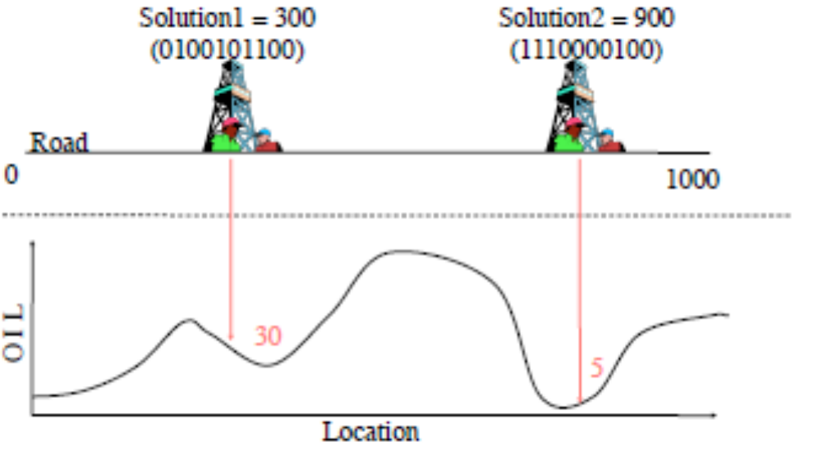
Drilling for Oil

Slide 14
Fitness
We have seen how to:
! represent possible solutions as a number
! encoded a number into a binary string
! generate a score for each number given a function of “how
good” each solution is - this is often called a fitness function
! Our silly oil example is trying to maximize a function f(x) over
the parameter space of x

Slide 15
Search Space
For a simple function f(x) the search space is one
dimensional
! But by encoding several values into the chromosome many
dimensions can be searched e.g. two dimensions f(x,y)
! Search space an be visualised as a surface or fitness
landscape in which fitness dictates height
! Each possible genotype is a point in the space
! A GA tries to move the points to better places (higher fitness)
in the the space

Slide 16
Search Space
Obviously, the nature of the search space dictates how a GA
will perform
! A completely random space would be bad for a GA
! Also GA’s can get stuck in local maxima if search spaces
contain lots of these
! Generally, spaces in which small improvements get closer to
the global optimum are good
17

Slide 17
Back to the (GA) Algorithm
Generate a set of random solutions
Repeat
Test each solution in the set (rank them)
Remove some bad solutions from set
Duplicate some good solutions
! make small changes to some of them
Until best solution is good enough

Slide 18
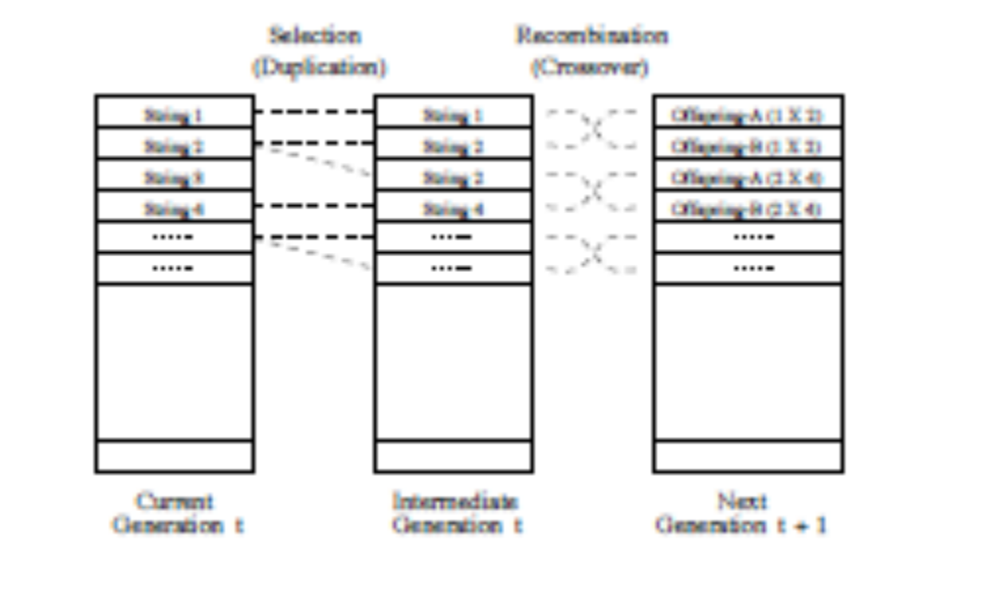
Outline of a Genetic Algorithm

Slide 19
Crossover
Although it may work for simple search spaces our algorithm
is still very simple
! It relies on random mutation to find a good solution
! It has been found that by introducing “sex” into the algorithm
better results are obtained
! This is done by selecting two parents during reproduction
and combining their genes to produce offspring

Slide 20
Crossover
Two high scoring “parent” bit strings (chromosomes) are
selected and with some probability (crossover rate)
combined
! Producing two new offspring (bit strings)
! Each offspring may then be changed randomly (mutation)

Slide 21
Selecting Parents
Many schemes are possible so long as better scoring
chromosomes more likely selected
! Score is often termed the fitness
! “Roulette Wheel” selection can be used:
! Add up the fitness's of all chromosomes
! Generate a random number R in that range
! Select the first chromosome in the population such that when all
previous fitness’s are added, gives you at least R

Slide 22
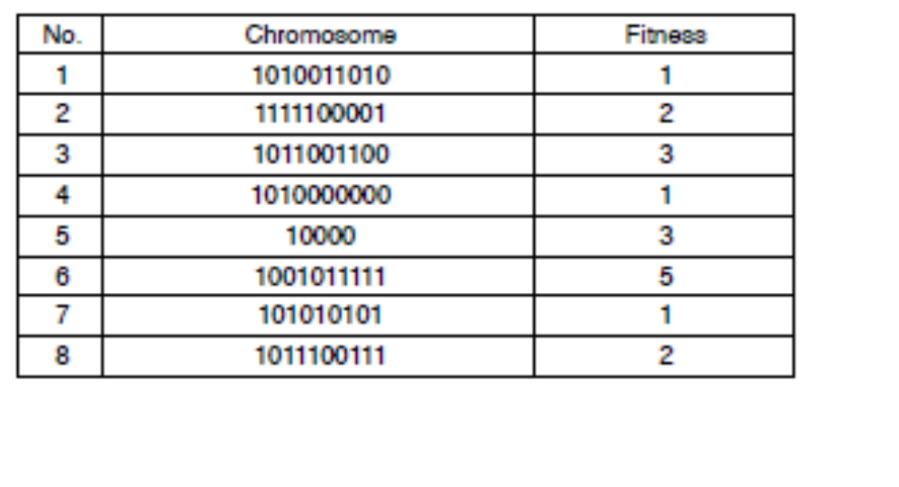
Example population

Slide 23
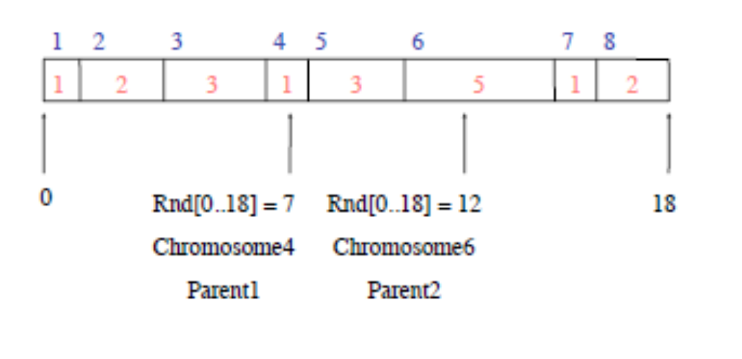
Roulette Wheel Selection

Slide 24
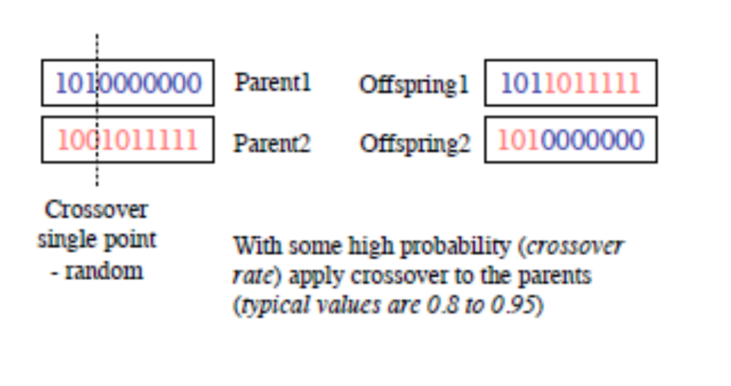
Crossover - Recombination

Slide 25
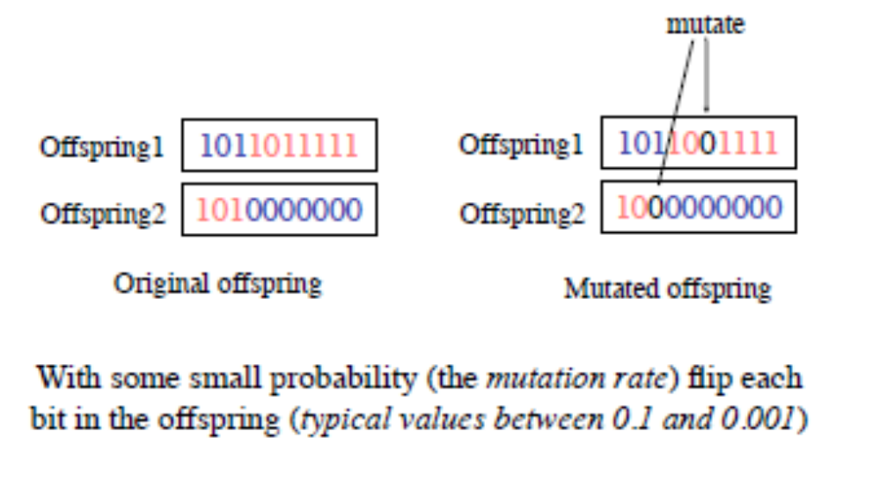
Mutation

Slide 26
Back to the (GA) Algorithm
Generate a population of random chromosomes
Repeat (each generation)
Calculate fitness of each chromosome
Repeat
Use roulette selection to select pairs of parents
Generate offspring with crossover and mutation
Until a new population has been produced
Until best solution is good enough

